Slide 1
Paywalls
Ian Reeves

Slide 2
What is a paywall?
A mechanism for allowing access to certain elements of published online content only to those users who have made some kind of payment.

Slide 3
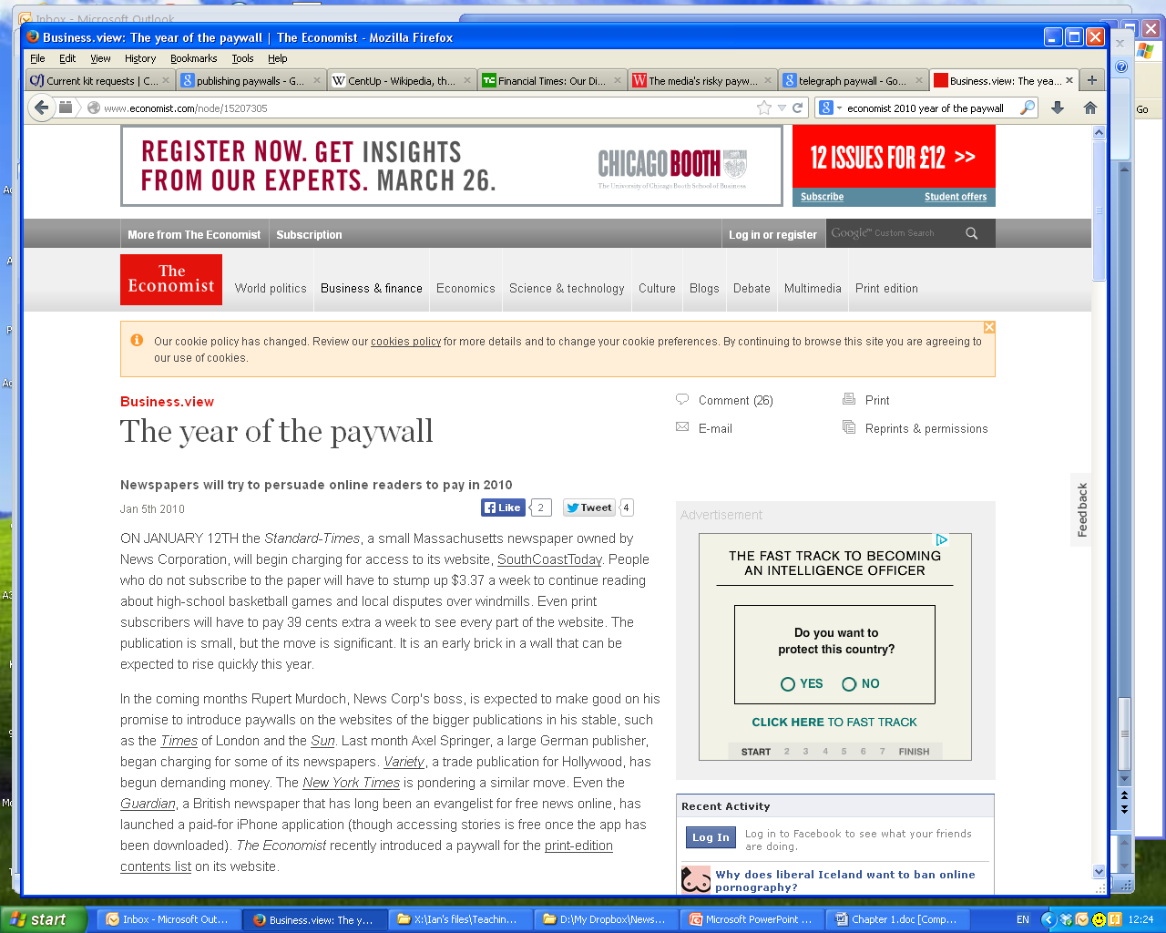

Slide 4
History of paywalls
First paywall from a major publication introduced by the Wall Street Journal in 1997
WSJ ained 200,000 paying subscribers in the first year. Now has more than 1m users.
Financial Times followed suit in 2001
FT digital subscribers reached 300,000 in 2012 – overtaking the number of print subscriptions

Slide 5
History of paywalls
But mainstream publications (as opposed to ‘niche’ financial ones) found it harder to make the paywall strategy work
New York Times implemented a paywall called TimesSelect in 2005, but dropped it 2 years later
LA Times began charging for entertainment content online in 2003, but dropped it 2 years later after 97% drop in readership

Slide 6
History of paywalls
In the UK, Johnston Press puts 6 of its regional newspapers behind a paywall in 2009, but abandons the experiment in 2010
The Times adopts a paywall in 2010, followed by The Sun in 2012
The Independent adds paywall in 2011 for users in USA and Canada, but not for UK users
The Telegraph brings in its new paywall system in 2013

Slide 7
Types of paywall
The ‘hard’ paywall
No content can be accessed without making a payment.
Considered a risky strategy
Can lead to up to 90% reduction in web traffic
Has negative effect on search engine optimisation
Loss of web traffic usually leads to loss of online advertising income
Example: The Times

Slide 8
Types of paywall
The soft paywall or ‘porous’ paywall:
Allows some content to be accessed free of charge to non-payers
Drop-off in traffic is more like 50% (see Chiou and Tucker)
Intended to lure readers in, and then encourage them to pay when free access runs out
E.g The Financial Times ‘metered’ paywall allows users to access 20 articles per month without paying
Has less impact on SEO and traffic
But can be circumvented – e.g RefSpoof and BreakThePaywall plugins for browsers

Slide 9
Types of paywall
The ‘Freemium’ model:
Essentially a 2-tier structure where some content is free, and other content is behind a paywall
E.g The Boston Globe ran 2 sites (the paywall site bostonglobe.com and free site boston.com) until March 2014

Slide 10
The economic calculation
The New York Times: metered paywall strategy
Claims around 750,000 digital subscribers
Has around 25 million visitors per month
Values these at around £100m per year
Also brings in additional digital revenue
But digital advertising revenue is falling at a rate of about 5% per year
Total digital revenue is about £55m per year

Slide 11
The economic calculation
The Guardian: free strategy
Around 78 million visitors per month
Total digital revenues of around £70m
But digital revenue is growing at around 25% per year
And revenue is no indication of profit – The Guardian is losing £30m per year overall.

Slide 12
The economic calculation
Daily Mail: free strategy
Around 130 million visitors per month
Expects its web sites to bring in more than £100m in annual revenue at some point in the next 3-5 years

Slide 13
The ethical calculation
Some scholars argue that paywalls have negative effect on public debate because they restrict an individual’s ability to read and share online news
Chiou and Tucker (2013): “The introduction of paywalls disproportionately excludes young readers, which undermines policymakers’ attempts to create a comprehensive community. Scholars have emphasized that newspaper readership as imperative to the promotion of democracy and civic engagement.”

Slide 14
The ethical calculation
Bronwen Clune: "the theory behind a paywall … is that people will pay for good investigative pieces that are in the interests of the general population. But if information is in the interests of the general population, how is putting it behind a paywall fulfilling the role of journalism?“
Kath Viner: “Journalists want to be paid, yes. And we want to find business models that make that possible - via advertising, partnerships, donation, cross-subsidy. But how could the future of journalism be safe behind a paywall, when the future of journalism is going on outside them?”

Slide 15
The ethical calculation
But paywall proponents argue that they are simply protecting the economic model through which journalists can be paid to investigate, hold power to account etc
Mass closure of newspaper websites would be far more anti-democratic, they argue
Dean Starkman: “…metered subscription models—all else being equal—is that they debunk the annoying and now disproved idea that journalism has no value in the marketplace. And they provide incentives for quality that click-chasing models, those based on sheer volume of posts and traffic, do not.”

Slide 16
Further reading
The Economist: the year of the paywall
CJR: Anti-paywall dead-enders
MediaWeek: The media’s risky paywall strategy
Paywalls and the demand for news, Chiou and Tucker
Dean Starkman: No paywalls please, we’re the Guardian
Kath Viner: Journalism in the age of the open web
Bronwen Clune: Big media can’t paywall the public interest

