Slide 1
JOURNALISTS AND THEIR SOURCES

Slide 2
Moral Obligation?
“Journalists have a moral obligation to protect confidential sources” –Editors’ Code of Practice
NUJ has a similar clause

Slide 3
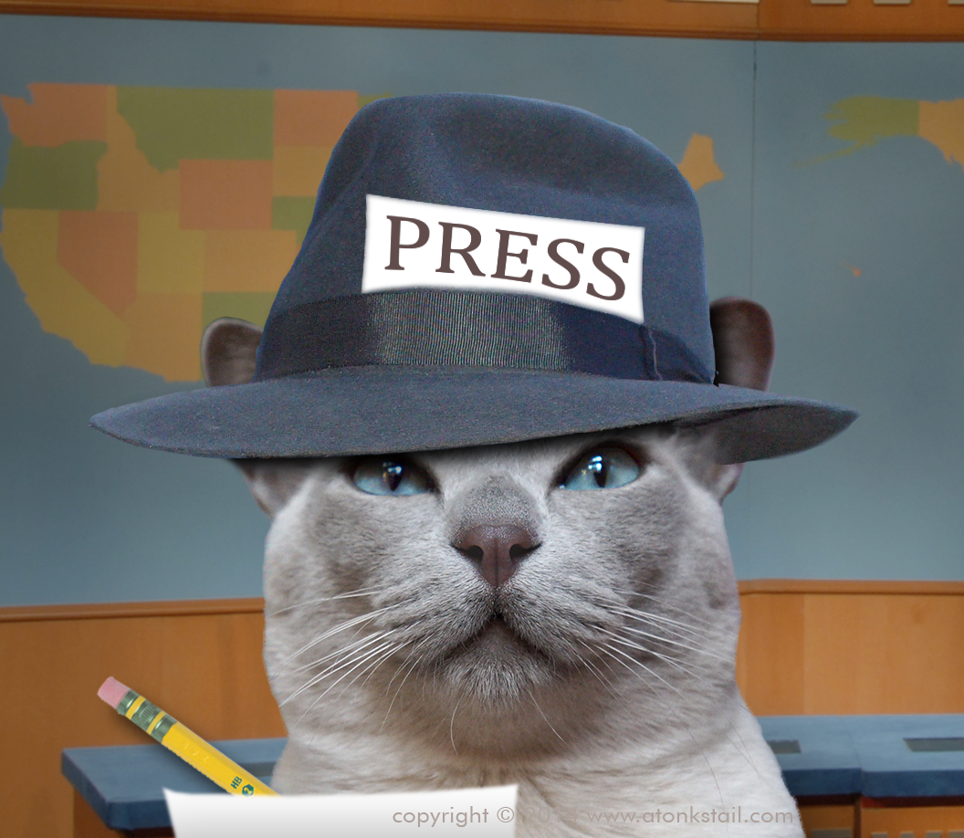
QUESTION 1
Why should journalists want to keep their sources confidential and why does the law recognise this?

Slide 4
‘….It is now clear that despite the ringing declaration of the ECHR on the importance of protecting confidential sources, journalists & editors cannot rely on national courts to take the same view.’
– Commissioner for Human Rights 2011

Slide 5
SOME ESSENTIAL LEGISLATION
Contempt of Court Act 1981
PACE 1984
Terrorism Acts 2000,2006 & other counter- terrorism measures. ‘Terrorism’ has wide meaning – e.g. actions against animal testing premises
Official Secrets Act 1989

Slide 6
Contempt of Court Act s.10
SHIELD LAW
Protects right not to disclose sources except in specific circumstances:
  Interests of national security
  Interests of justice
  For the prevention of crime
  For the prevention of disorder
Reasons for protection ..............

Slide 7
PROTECTION required.....
Sources may be concerned about their safety..
Their employment.....even though there is now some protection for whistleblowers in the law
Good investigative journalism relies on information from individuals
If no confidentiality, sources may refuse to come forward
‘The watchdogs of society’

Slide 8
JEREMY WARNER CASE
City journalist Jeremy Warner was asked for sources for a business story he wrote for The Independent
REFUSED was fined 20,000
INTERPRETATION of phrases in 1981 Act by Lord Griffiths
  ‘NECESSARY’ = somewhere between ‘indispensable’ on the one hand and ‘useful’ or ‘expedient’ on the other
  ‘PREVENTION OF CRIME’ appears to be broad not limited to situation in which identity of the source would allow steps to be taken to prevent the commission of a particular future identifiable crime PACE 1984

Slide 9
CASES TO REMEMBER
Sarah Tisdall – Information to Guardian
X v Morgan Grampian Publishers (1991) (The Goodwin case)
The Ashworth Hospital cases
  Ashworth Security Hospital v MGN Ltd (2002)
  Mersey Care NHS Trust v Ackroyd (2006)
Suzanne Breen (Irish case)
Recent ECtHR decisions ‘Interbrew’ & ‘Sanoma’
MURRER case

Slide 10
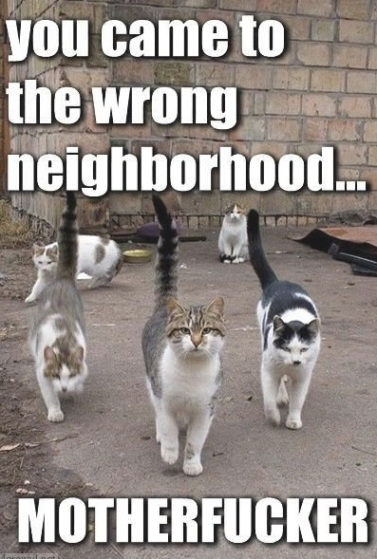
Suzanne Breen
2009 Judge ruled that Art 2 (Right to life) of Suzanne Breen was breached
Editor of Ireland’s Sunday Tribune
She had police notes and phone call records from Real IRA group
Court ruled that if she disclosed info her life would be in danger

Slide 11
Guardian & Sarah Tisdall
NATIONAL SECURITY
1983 The Guardian was ordered to return a leaked photocopy of a MoD doc revealing strategy for US Cruise nuclear missiles, due to be based in the UK.
Guardian didn’t know the name of the source, BUT thought you could guess from analysing the doc
HoL said that the interests of national security required disclosure of the informant’s ID – find the leak in the MoD
Sarah Tisdall, Foreign Office clerk was convicted under Official Secrets Act + 6 months jail
What if the Guardian had burned doc after using it?

Slide 12
Ashworth Hospital cases
2000 Ashworth High Security Hospital obtained an order that the Daily Mirror disclose source of a story on Moors murdered Ian Brady and his treatment at hospital
Brady killed five children, Greater Manchester, some sexually assaulted
2002 Court of Appeal and HoL said that while disclosing sources had a “chilling effect” on freedom of the press it was “necessary, and proportionate and justified”
Freelance journo Robin Ackroyd said he wrote story, but refused to reveal sources
2003 went to full trial because Ackroyd’s source was not paid
2006 judge ruled in favour of Ackroyd, need for patient confidentiality files is not enough to override freedom of press

Slide 13
Is the disclosure of the source necessary?
3 stage test formulated by counsel in Ashworth Security Hospital v MGN Ltd [2001] FSR 559
  a. Are the interests of justice engaged?
  b. If so, the court has to consider whether disclosure is necessary to achieve the relevant ends of justice
  c. As a matter of discretion, court then has to weigh the specific interests of claimant against the public interest in the protection of the source.

Slide 14
EFFECT OF HUMAN RIGHTS
SEE COMMENTS OF ECtHR IN - Goodwin, Tillack, Sanoma and Interbrew
Has the Article 10 right to freedom of expression been breached?
Was it necessary?
Article 2 – right to life
Promotes role of press as a watchdog - sometimes!
Recognise that it is necessary to protect journalists’ sources to uphold human rights and freedom???

Slide 15
The Goodwin Case
Bill Goodwin, trainee reporter on the Engineer magazine
1989 High Court ordered him to reveal source for story on engineering company’s financial problems
REFUSED
Fined 5,000 pounds for Contempt of Court
Court of Appeal and HoL held up the decision because the company had a right to know who was leaking information
1996 ECHR ruled that UK courts had breached Goodwin’s Art 10 (Freedom of Expression and Info)
Right to protect journalistic sources is a basic condition for press freedom

Slide 16
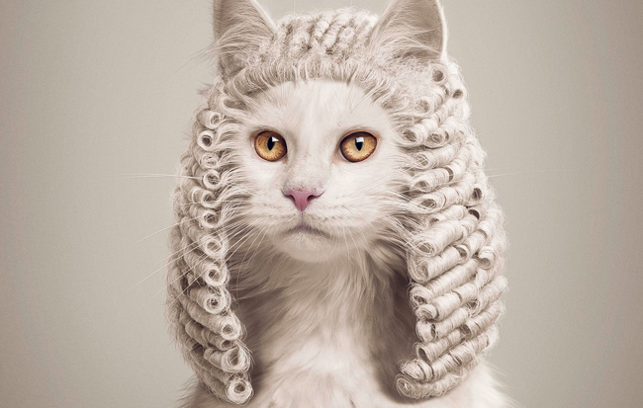
QUESTION 3
Look at the Sanoma and Goodwin cases. What approach does the ECHR take to the protection of journalists sources?

Slide 17
A dilemma for journalists?
The ethical problems
The effect of maintaining the confidence – see Ackroyd
  Journo source of Ashworth hospital story
The effect of NOT maintaining the confidence - see e.g. of Nick Martin-Clark
HANDOUT AND DISCUSS
What would YOU do?

Slide 18
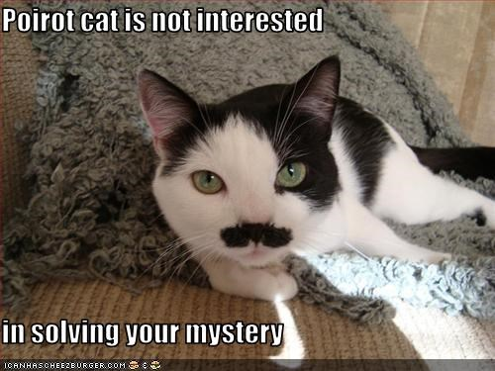
QUESTION 2
Dee, freelance journalist case

Slide 19
LEGISLATION ALLOWING SEIZURE AND COMPULSION OF ID OF SOURCES
Police need JUDGE’S APPROVAL to request journalistic info or search premises
Increased in recent years
PACE 1984
  Protects “journalistic material” – material acquired or created for the purposes of journalism.
RIPA 2000
Terrorism Act 2000
The Anti-Terrorism Crime & Security Act 2001
Serious Organised Crime & Police Act 2005
And there are more........

Slide 20
DANGERS OF CHALLENGE OR REFUSAL
R v Central Criminal Court ex parte Martin Bright (2001) (Martin Bright case)
  Guardian Journo Martin Bright wrote an article using a letter from a ex MI5 officer saying MI6 officers were involved in a failed attempt to kill Col Gaddafi.
  Wanted an email letter sent to Bright, to discover email address of MI5 agent who leaked it.
  Court rejected a police app for Bright to surrender docs
R (on the application of Malik) v Manchester Crown Court (2008)
  A freelance journalist, sought judicial review in respect of the granting of a production order pursuant to the Terrorism Act 2000 Sch 5, under which he was required to provide journalistic material to the Manchester police.
  The material related to a book which C was writing in colloboration with B, who claimed at the time to be an ex-associate of Al-Quaeda.

Slide 21
PACE 1984
Must apply to High Court judge, recorder or circuit judge
Judge produces a “production order”
Allows police to apply for a search warrant, Journo doesn’t have to be notified but has to satisfy a circuit judge of need.
Journalistic material falls within both excluded material (confidential journalistic material) and special procedure material (non confidential journalistic material)
can only be seized by the police if they apply for a warrant under Section 9 of PACE 1984

Slide 22
Excluded Material
S.8 provisions = ‘Excluded material’ – journalistic material that a person holds in confidence CONFIDENTIAL
  For example: stolen material doesn’t count because it would be liable for instant surrender under Theft Act 1968.
…will only be granted where the judge has reasonable grounds to believe that such material exists at premises specified in the application and that:
  Another statute would, were it not for the protection of such material given by PACE have allowed a police officer access to such material and
  Such access would have been appropriate

Slide 23
Material held in confidence when..
A. they hold it subject to an express or implied undertaking to hold it in confidence or subject to a restriction on disclosure or an obligation of secrecy contained in any Act of Parliament and
B. it has been continuously held (by one or more persons) subject to such an undertaking, restriction or obligation since it was first acquired or created for the purposes of journalism.

Slide 24
‘SPECIAL PROCEDURE’ MATERIAL
NON CONFIDENTIAL JOURNALISTIC MATERIAL
Procedure for seizure more relaxed
Application to circuit judge (Crown Court Judge) required.
Parties can make representations

Slide 25
‘………..a serious inroad….’
‘The special procedure…...is a serious inroad upon the liberty of the subject. The responsibility for ensuring that the procedure is not abused lies with circuit judges. It is of cardinal importance that circuit judges should be scrupulous in discharging that responsibility.’ (R v Maidstone Crown Court ex pa Waitt [1988] Crim LR 384)
PACE 1984 balances two interests:
  public interest in the effective investigation and prosecution of crime
  public interest in protecting the personal and property rights of citizens against infringement and invasion.

Slide 26
TRUST?
Sometimes police want unpublished photos and footage
To identify other people (i.e. at riots)
If journos do this often, people will see them as an arm of the state
ARGUMENT: It is not in the public interest to stop journalists from doing their job.

Slide 27

QUESTION 4
Do you think there are any circumstances when sources’ identities should be revealed? If so when?

Slide 28
MORE CASES
Poll tax riots & riots in 2011
  BBC, ITN and Sky handed over footage after “production orders”
R (on the application of BSkyB, the BBC, ITN, Hardcash Productions Ltd & Jason Parkinson) v Chelmsford Crown Court [2012] EWHC 1295
  2012 High Court overturned order by a judge in Chelmsford Crown Court about +1,000 footage of evictions from Dale Farm travellers site.
Metropolitan Police attempt to get order under Official Secrets Act re Millie Dowler information
  Tried to get Guardian info on source for revealing phone hacking scandal

Slide 29
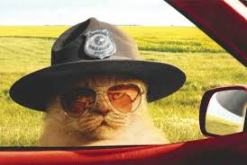
QUESTION 5
DIVIDE UP IN FOUR TEAMS

Slide 30
MORE legislation…
Official Secrets Act 1920
  Section 1 – covering espionage
  Police may ask the Home Secretary to ask someone to produce documents
  Section 9- let’s police make searches subject to PACE 1984 as re regards journalistic material.
Terrorism Act 2000
  Enables a court to issue a warrant for police investigating a terrorist offence to search premises
  Offence punishable by 5 years jail if you fail to inform the police about possible terrorist activity

Slide 31
Surveillance
Police Act 1997 allows police to survey journalists in touch with secret sources yielding info on serious crime
Regulation of Investigatory Powers Act 2000 (RIPA) allows police to monitor phone calls and emails, surveillance powers. Sec of State approves, no judge.
  SALLY MURRER CASE
  2008 Milton Keynes reporter Sally Murrer and Mark Kearney, ex detective
  Kearney was accused of leaking info
  Walked FREE because court ruled that info obtained by police by bugging MR Kearney’s car was inadmissible
  Information wasnt sensitive
  Violated art 10 for both + Murrer’s right to protect her sources

Slide 32
http://www.channel4.com/producers-handbook/media-law/
GREAT SOURCE!!!

Slide 33
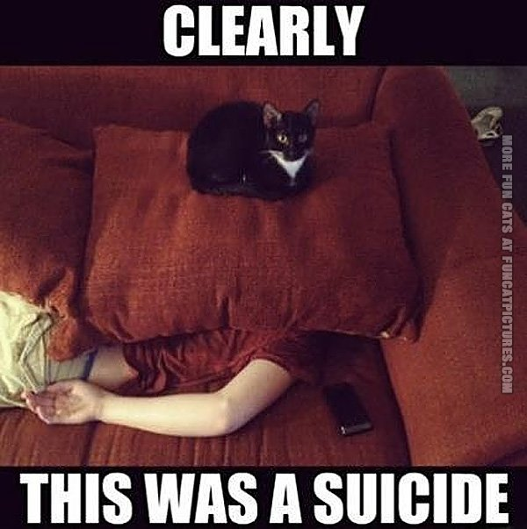
Good news, and bad news…

