Slide 1
Police & Crime Commissioners

Slide 2
What are they?
Elected representatives who ensure police forces are running effectively
41 in England + Wales (first election 2011)
Replaced police authorities (appointed)
Role is strategic not operational
Chief constables run forces (operational)

Slide 3
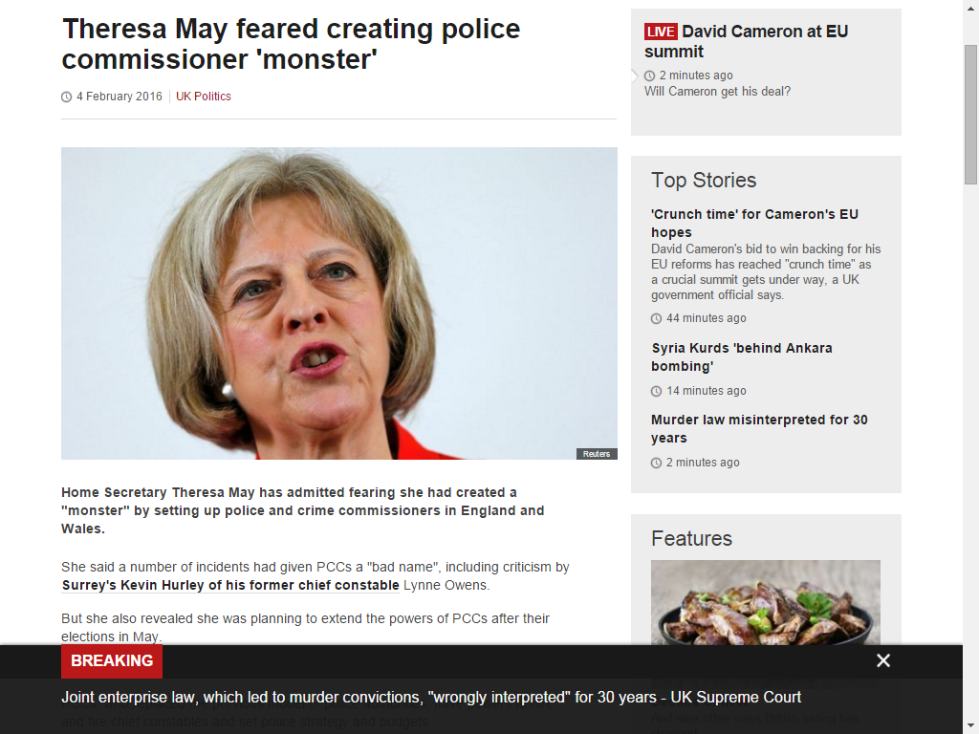

Slide 4
Responsibilities of commissioners
Appointing+dismissing chief constables
Holding the chief constable to account for performance of force
Providing a link between the police + communities
Setting police budget + police ‘council’ tax levy
Providing police strategy through Police and Crime Plan

Slide 5
Crime commissioners
Not political – must swear oath of impartiality on taking office
Does not mean political parties are barred from standing candidates in election
Are accountable/overseen by Crime Panels – represented by local councillors and some lay representatives
Salaried – paid on average between £85,000 and £100,00

Slide 6
Kent commissioner
Ann Barnes (who earns £85k in role)
Apolitical – stood as independent despite disagreeing with the idea and concept of commissioners
High-profile:
Youth crime tsar
£150k cost of office move
Channel 4 fly-on-the-wall documentary

Slide 7
Oversight
Commissioners are accountable to Crime Panels – largely made up of local councillors
Quizzed on anything they have done - or not – at public meetings
Sign off on budget
Ratify commissioners yearly crime plans which set out policies and proposals

Slide 8
Future...?
Elections in May
Seven declared candidates in Kent
Supplementary vote system used
Could get beefed up powers – take over fire services? Open free schools?

Slide 9
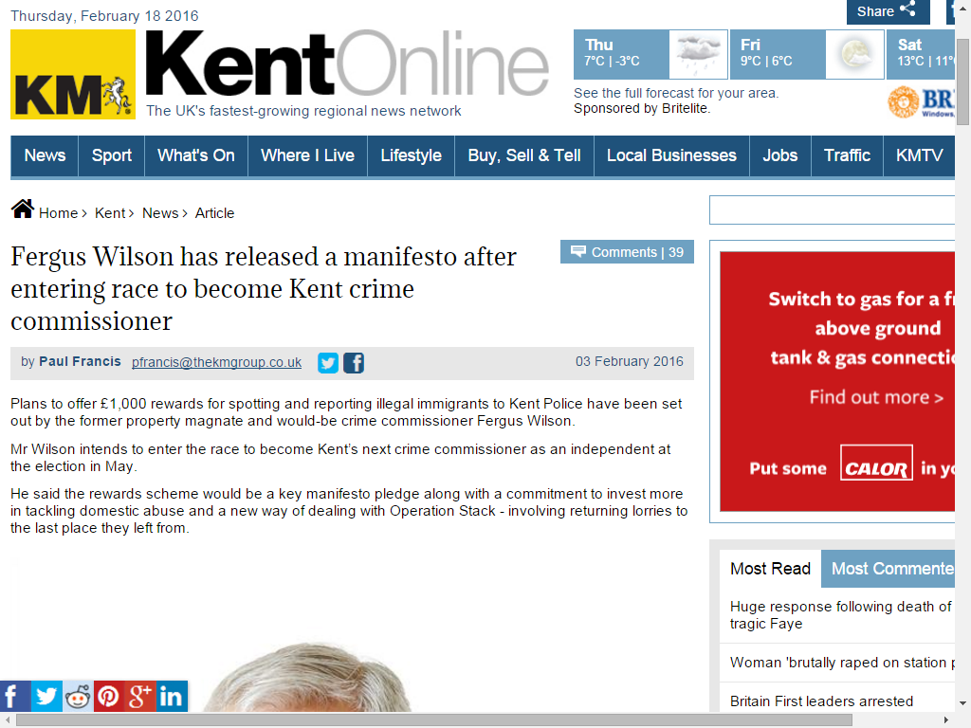

Slide 10
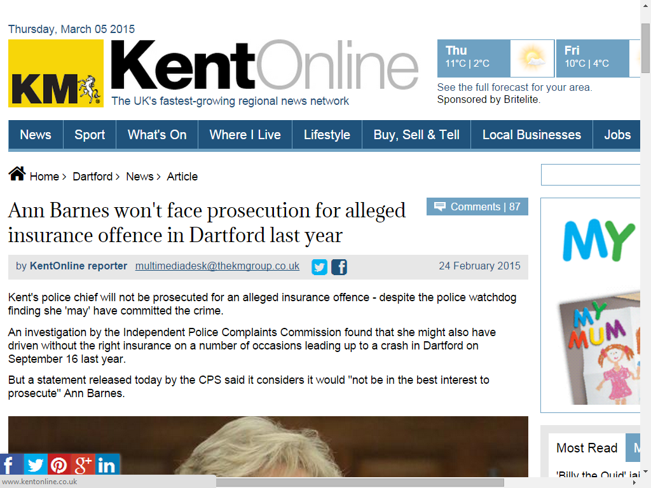

Slide 11
